Slide 1

Module 1 - Video 1.2
From Waze map to data

Slide 2
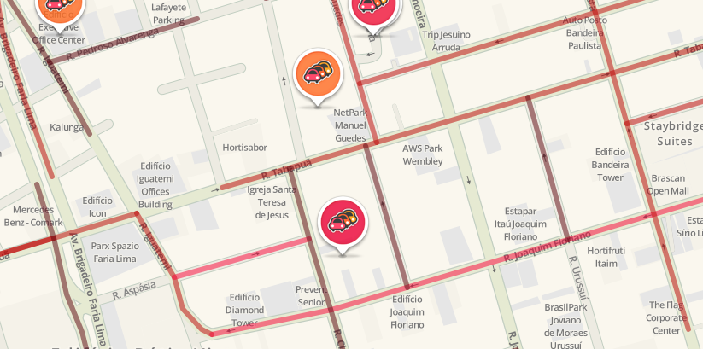
Notes:
Well, the data provided is actually the same that appears on the app.
You may be familiar with this image. It is the map that every wazer in São Paulo, Brasil, looks to at rush hour.
Here, you can see two types of data: JAMS AND ALERTS

Slide 3
JAMS
ALERTS
Notes:
The Jams, are those red lines.
The icons are alerts. In this particular image, we can only see one type of alerts, a jam alert.
But, there are plenty of alerts that wazers can share.
PotHoles, traffic light faults, accidents and others.
Let’s take a closer look to the data that each alerts carries.

Slide 4
Map to alerts
Time
2018/09/20, 23h55
Address
R. Claudomiro Amazonas, São Paulo, Brasil
Type
Jam: stand-still traffic
Location
Latitude: -23.585318
Longitude: -46.679824
…
Notes:
Each alert has, at least,
a timestamp
an address
a Type
and a geographic location.
So, each of those alerts, carries some information that we, CCP partners, can access and analyze.
We are going to dive in the complete jam and alerts information in the next videos.

Slide 5
Map to jams
Time
2018/09/20, 23h55
Address
R. Iguatemi, São Paulo, Brasil
Speed
4.33 km/h
Location
Latitude Longitude
Notes:
the jams also carries time and address information.
Differently than alerts, it has the current speed of the jam segment.
A jam segment, is a set of smaller road segments.
If we look closely, we are going to see that this segment is not curved, but a bunch of small connected lines.
Each of these small lines, road segments, are represented by two points with a corresponding latitude and longitude.
So, every jam segment is represented by a set of latitude and longitudes.

Slide 6
Map to jams
Time
2018/09/20, 23h55
Address
R. Iguatemi, São Paulo, Brasil
Speed
4.33 km/h
Location
Latitude Longitude
-23.584837 -46.682061

Slide 7
Map to jams
Time
2018/09/20, 23h55
Address
R. Iguatemi, São Paulo, Brasil
Speed
4.33 km/h
Location
Latitude Longitude
-23.584837 -46.682061
-23.585574 -46.681589

Slide 8
Map to jams
Time
2018/09/20, 23h55
Address
R. Iguatemi, São Paulo, Brasil
Speed
4.33 km/h
Location
Latitude Longitude
-23.584837 -46.682061
-23.585574 -46.681589
-23.585937 -46.681475

Slide 9
Map to jams
Time
2018/09/20, 23h55
Address
R. Iguatemi, São Paulo, Brasil
Speed
4.33 km/h
Location
Latitude Longitude
-23.584837 -46.682061
-23.585574 -46.681589
-23.585937 -46.681475
-23.586171 -46.681242

Slide 10
Map to jams
Time
2018/09/20, 23h55
Address
R. Iguatemi, São Paulo, Brasil
Speed
4.33 km/h
Location
Latitude Longitude
-23.584837 -46.682061
-23.585574 -46.681589
-23.585937 -46.681475
-23.586171 -46.681242
-23.586229 -46.681111

Slide 11
Map to irregularity
Time
2018/09/20, 23h55
Address
R. Iguatemi, São Paulo, Brasil
Speed
4.33 km/h
Location
Latitude Longitude
-23.584837 -46.682061
-23.585574 -46.681589
-23.585937 -46.681475
-23.586171 -46.681242
-23.586229 -46.681111
Notes:
Also, there is a particular data type called irregularity.
It shows the jams that are irregular.
Under the hoods, waze knows what jams are supposed to happen at a certain time and day of the week.
If there is a jam that were not predicted, Waze reports it to a particular data type called irregularities.

Slide 12
In the next video...
JSON
XML
Notes:
Now, that we saw what are the available data.
Let’s understand how this data is structured.

Slide 13
See you in the next video!

